Slide 1
Exam 2: Forces
Chapters 4 & 5
Newton’s 2nd Law, weight, friction, normal force, tension

Slide 2
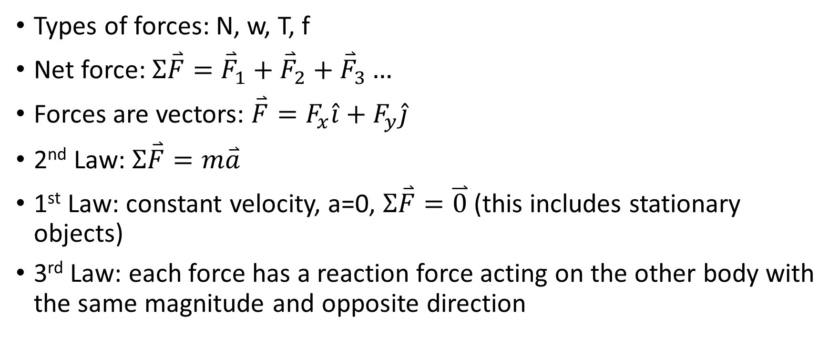
Chapter 4
Types of forces: N, w, T, f
Net force: $Σ\overset{⃑}{F}=$ ${\overset{⃑}{F}}_{1}+{\overset{⃑}{F}}_{2}+{\overset{⃑}{F}}_{3}…$
Forces are vectors: $\overset{⃑}{F}=F_{x}\hat{i}+F_{y}\hat{j}$
2nd Law: $Σ\overset{⃑}{F}=m\overset{⃑}{a}$
1st Law: constant velocity, a=0, $Σ\overset{⃑}{F}=\overset{⃑}{0}$ (this includes stationary objects)
3rd Law: each force has a reaction force acting on the other body with the same magnitude and opposite direction

Slide 3

Chapter 5
Friction
Static = stationary $f_{s}≤μ_{s}N$
Kinetic = moving $f_{k}=μ_{k}N$
Circular motion
$ΣF=\frac{mv^{2}}{R}$
$a=\frac{v^{2}}{R}$

Slide 4
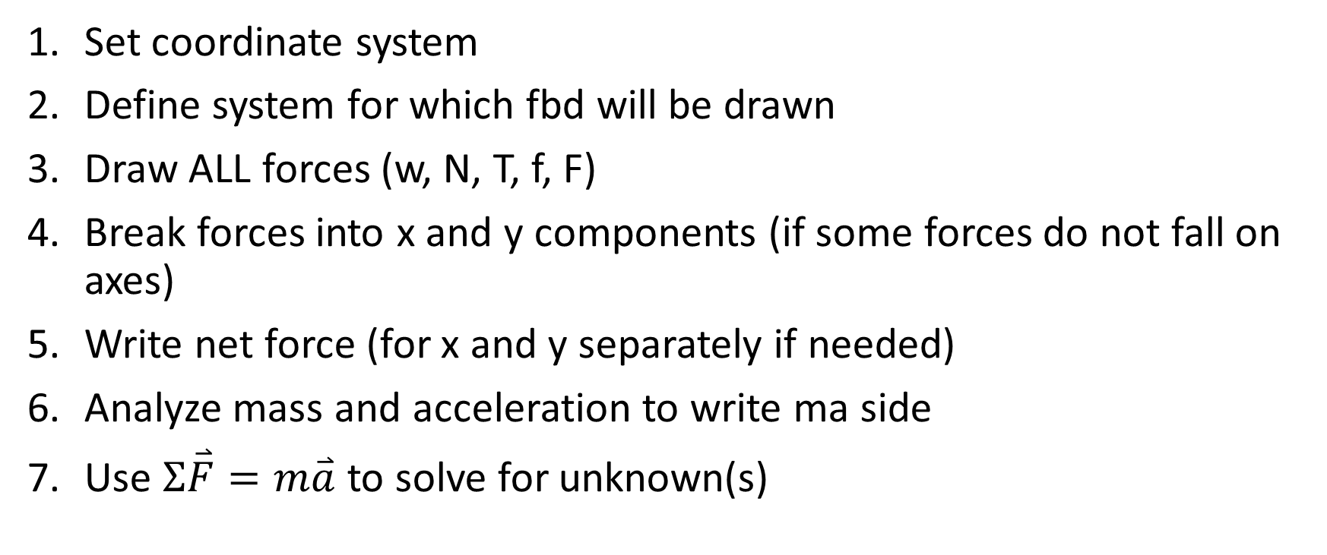
Analyzing forces & drawing free body diagrams
Set coordinate system
Define system for which fbd will be drawn
Draw ALL forces (w, N, T, f, F)
Break forces into x and y components (if some forces do not fall on axes)
Write net force (for x and y separately if needed)
Analyze mass and acceleration to write ma side
Use $Σ\overset{⃑}{F}=m\overset{⃑}{a}$ to solve for unknown(s)

Slide 5
An elephant on skis is pulled up a ski slope at constant velocity. The elephant’s mass is 200 kg and the slope is at an angle of 20 degrees above the horizontal. Find the tension in the rope pulling the elephant, given that the rope is parallel to the slope.
670 N

Slide 6
A 500 kg elephant sits on a scale in an elevator. If the weight on the scale reads 6000 N, what is the acceleration of the elevator?
2.2 m/s^2

Slide 7
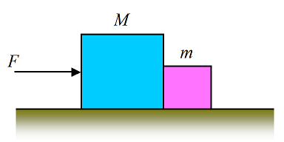
Two boxes are being pushed across an icy lake with a force of 3 N. The first box weighs 10 N and the second weighs 2 N. Find the force the left block exerts on the right block and the acceleration of the two blocks.
0.5 N, 2.45 m/s^2

Slide 8
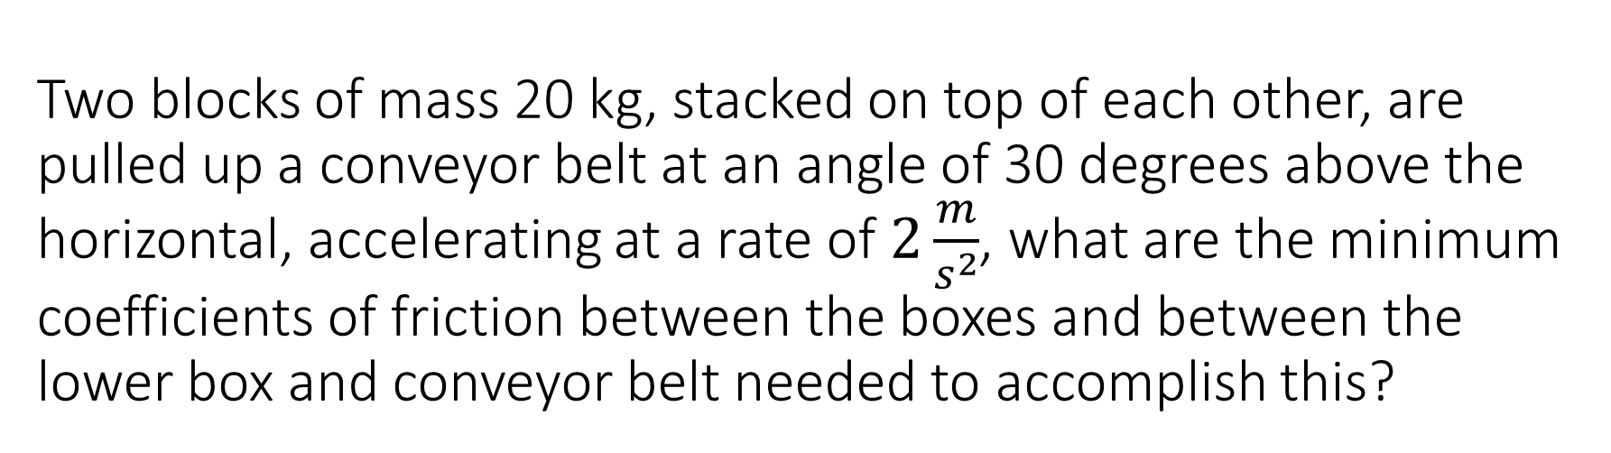
Two blocks of mass 20 kg, stacked on top of each other, are pulled up a conveyor belt at an angle of 30 degrees above the horizontal, accelerating at a rate of $2\frac{m}{s^{2}}$, what are the minimum coefficients of friction between the boxes and between the lower box and conveyor belt needed to accomplish this?
0.81, 0.81

Slide 9
A 2.0 m rope is fixed at one end to a vertical wall and a ball of mass 3 kg and diameter 40 cm hangs from the other end. Find the tension in the rope and the normal force between the ball and wall.
29.5 N, 2.69 N

Slide 10
An elephant with a mass of 300 kg is lifted from rest to 10 m off the ground in 4 s with constant acceleration. Find the tension in the rope as the elephant is lifted.
3315 N

Slide 11
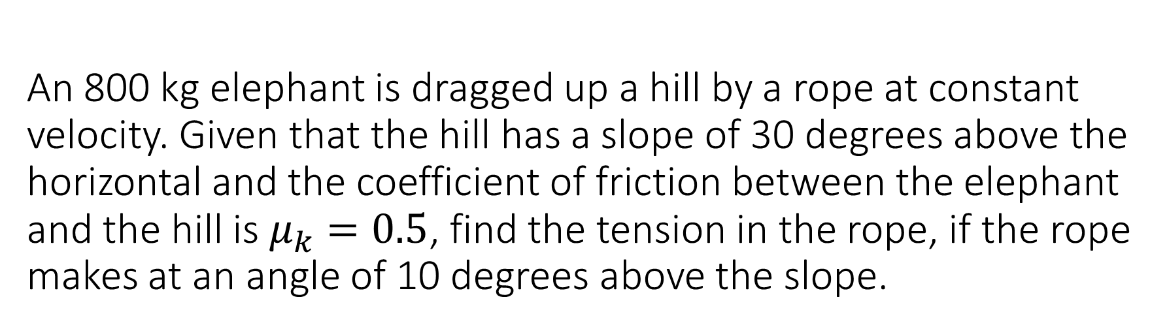
An 800 kg elephant is dragged up a hill by a rope at constant velocity. Given that the hill has a slope of 30 degrees above the horizontal and the coefficient of friction between the elephant and the hill is $μ_{k}=0.5$, find the tension in the rope, if the rope makes at an angle of 10 degrees above the slope.
6826 N

Slide 12
A 90 kg roller coaster car and goes around a circular loop of radius 30 m. If the speed at the top of the loop is 100 m/s, what is the normal force the car experiences? What is the minimum speed needed to make it around the loop without loosing contact?
29000 N, 17.1 m/s

Slide 13
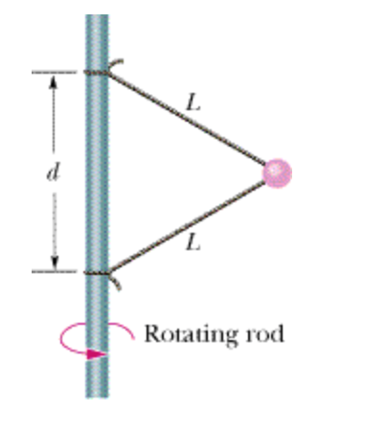
A 1 kg ball is connected to a rod by two ropes as shone. If the ball rotates around the rod at a rate of 300 revolutions per minute, what are the tensions in each of the ropes if L 1.5m and d = 2.0 m?
745 N, 731 N

Slide 14
Two blocks m1= 9.4 kg and m2 = 4.9 kg are connected by a rope that has a mass of mr = 1.42 kg. A constant vertical force, F = 184.9 N, is applied to the upper block (m1). What is the magnitude of the acceleration of the system? What is the magnitude of the tension in the rope at the bottom end of the rope?
1.96 m/s^2, 57.6 N,

